Slide 1
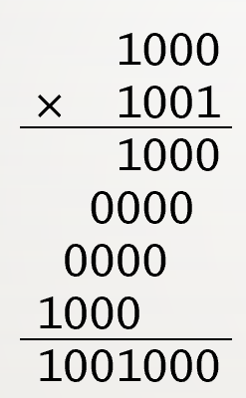
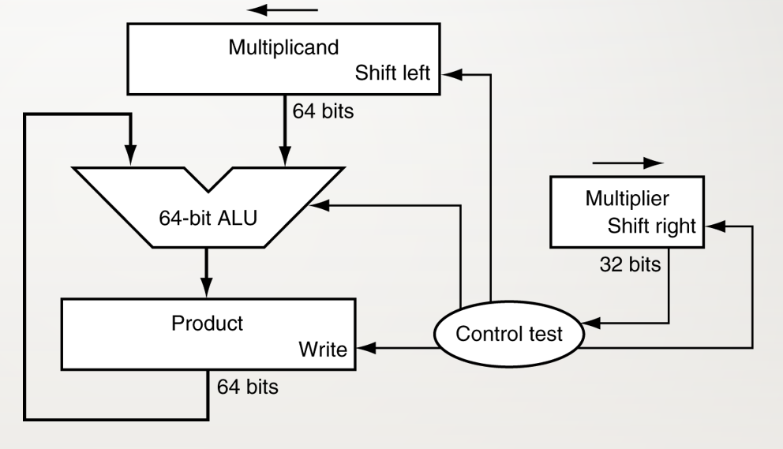
Quiz 2 Arithmatic Operations
(6 points) The figure on the right shows the multiplication of two binary numbers.
Which steps can be done in parallel?
Which steps can be done in a pipeline?
(6 points) Why is it that adding two negative operands may overflow, but subtracting two negativeve operands may not? What does overflow mean?
(4 points) For the decimal number -0.85, write it down in (a) binary representation, and (b) in IEEE 754 format.
(4 points) The figure on the right shows a simple multiplier. Why is the product register 64 bits, not longer and not shorter?

